Slide 1
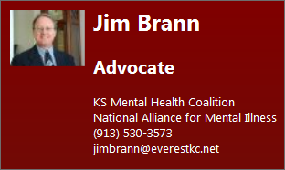
Corporate Initiative Proposal
Presented by Jim Brann
Advocate
For Kansas Mental Health Coalition

Slide 2
MISSION STATEMENT:
Solicit Kansas Company executives and employees to become advocates for Kansas Mental Health and provide financial support.

Slide 3
PROCESS:
Engage Wyandotte and Johnson County company executives using my personal story along with information from the “Heartland Study” and information from the Health Care Foundation of Greater Kansas City study “The Costs of Untreated Mental Illness in Greater Kansas City”.
Initiative will use “Top Company Lists” along with research about subject companies and their executives, a minimum of 50 companies will be engaged;
Preparation of an Executive Briefing presentation to incorporate the message and request for action and support;
Presentations will be made to executives one on one, at staff meetings and at company employee events;
Initial engagements will be to companies and executives deemed “friendly to the cause” to gain traction and endorsements;
Purpose is to educate especially to de-stigmatize MI, solicit for Advocacy, and solicit for financial support.

Slide 4
Recommendations
Become a 501(c)3 to facilitate KMHC:
  Recruiting and training Advocates,
  Educating companies, their employees and the public about Mental Health and Mental Illness to “de-stigmatize MH & MI”,
  Marketing,
  Administration,
  Enhance KMHC Website to ensure currency and ability to process credit card transactions,
  Host annual legislative events,
  Host community and business events,
  Professional publication of information, e.g. education, advocacy materials, etc.,
  Annual Board Strategic Planning retreat,
  Online Advocacy Training program, and
  Host Mental Health First Aid and or CIT events.
Phased Approach
  Initiate program in Wyandotte and Johnson County,
  Subscribe to KC Biz Journal ($100 for 12 month subscription),
  Submit request for 501(c)3 (approximately $1,000),
  Create Corporate Sponsorships Program
  Create Individual Sponsorships Program
  Approve KMHC Logo
  Logod Gear Proposal
  Success criteria:
    50 Companies engaged,
    Greater than $100,000 contributed,
    50 new Advocates recruited.
  Next Steps if Successful:
    Acquire Hoover’s,
    Identify and “recruit” Advocates for Topeka and Wichita.
Timeframe:
  Review initiative 6/25 (complete),
  Board discussion initiated and complete by next meeting,
  Board and membership review and go / no-go decision – 7/23,
  Go forward in 2015 or not – December Board meeting.

Slide 5
501(c)3 Processes and Documentation
A 501(c)(3) and 501(c)(4) are both tax-exempt organizations and do not have to pay taxes on the money donated to the organization, but only the donations provided to a 501(c)(3) are a tax write-off for the donors. Donating to a 501(C)(4) organization does not allow the donor to write-off the donation --- except for a few limited types of organizations, such as fire or rescue or certain types of veterans' organizations, as described in the IRS code. A 501(c)(3) must also provide the donor with a receipt for the amount of the donation or a receipt for the value of the donation, while the 501(c)(4) does not have to do the same.
Kansas Requirements and Forms:
http://kslegislature.org/li/b2013_14/statute/017_000_0000_chapter/017_017_0000_article/017_017_0063_section/017_017_0063_k/
http://www.kssos.org/forms/business_services/SC.pdf
http://www.multistatefiling.org/
IRS Requirements and Forms
http://www.irs.gov/Charities-&-Non-Profits/Private-Foundations/Life-Cycle-of-a-Private-Foundation-Applying-to-the-IRS
Return

Slide 6
Kansas City Business Journal Features Weekly Edition
Filled with "must read" stories, industry news and reporter insights, exclusive interviews with local business leaders, and expanded Top 25 Lists
Apple Newsstand App
FREE access to Weekly Editions on your iPad or iPhone
Morning & Afternoon Editions
Daily breaking business news and local market intelligence delivered twice daily emails
Exclusive Online Tools
Research the 3+ year digital archive, and People on The Move leads database download
FREE Book of Lists (a $65.00 value) *
Start using the Digital Book of Lists today and receive the Printed Book of Lists when next published *
Return

Slide 7
Corporate Sponsorships
Platinum
  Annual contribution to KMHC of $50,000
  Joint News Release
  Honorary membership on KMHC Board of Directors
  Corporate Link on KMHC Website
  Listed as a Platinum Corporate Sponsor on KMHC Website
  Participation in KMHC semi-annual Round-tables
  50 Logo’d Gear Premium “Corporate / KMHC” Golf Shirts
Gold
  Annual contribution to KMHC of $25,000
  Corporate Link on KMHC Website
  Listed as a Gold Corporate Sponsor on KMHC Website
  Participation in KMHC semi-annual round-tables
  25 Logo’d Gear Premium “Corporate / KMHC” Golf Shirts
Silver
  Annual contribution to KMHC of $10,000
  Listed as a Silver Corporate Sponsor on KMHC Website
  Participation in KMHC semi-annual round-tables
  10 Logo’d Gear Premium “Corporate / KMHC” Golf Shirts
Bronze
  Annual contribution to KMHC of $5,000
  Listed as Bronze Corporate Sponsor on KMHC Website
  5 Logo’d Gear Premium “Corporate / KMHC” Golf Shirts
http://logodgear.com/ More Shirts available for purchase
Return

Slide 8
Individual Sponsorships
Board of Director’s Sponsor
  Annual contribution to KMHC of $2,500 or more
  Honorary membership on KMHC Board of Directors
  KMHC Membership
  Listed as a Board of Directors Individual Sponsor on KMHC Website
  Participation in KMHC semi-annual Round-tables
  Logo’d Gear Premium “Personalized KMHC” Golf Shirt
President’s Sponsor
  Annual contribution to KMHC of $1,500 to $2,499
  KMHC Membership
  Listed as a President’s Individual Sponsor on KMHC Website
  Participation in KMHC semi-annual round-tables
  Logo’d Gear Premium “Personalized / KMHC” Golf Shirt
Individual Sponsor
  Annual contribution to KMHC of $1,000 to $1,499
  KMHC Membership
  Listed as an Individual Sponsor on KMHC Website
  Participation in KMHC semi-annual round-tables
  Logo’d Gear Premium “Personalized / KMHC” Golf Shirt
http://logodgear.com/ More Shirts available for purchase
Return

Slide 9
KMHC Logo
Return

Slide 10
Logo’d Gear
The Logo'd Gear philosophy is Stay in Front of Your Customers! As your premier provider of promotional products, we understand the need to maintain customer loyalty by keeping your brand in front of your clients.
Does your company participate in tradeshows? We invite you to take a look at our fun and affordable tradeshow promotional item's, including corporate giveaways, custom printed bags, imprinted pens, coffee mugs, embroidered shirts and calendars.
We are especially proud of our ongoing efforts to help clients who are Going Green with our extensive product line of green promotional products and eco-friendly apparel.
We know that each of our customers has specific needs in how to brand their message and how to best service their internal and external clients. Although we have an extensive catalog of promotional products, our customer service is what keeps our customers coming back – we are happy to work with you to find the best promotional merchandise for you, your budget, and your marketing plans.
Ordering directly from our site is easy; simply click on any of the links to the left to start shopping, or feel free to call us directly at (704) 334-9333.
We are headquartered in Charlotte, North Carolina.

Slide 11
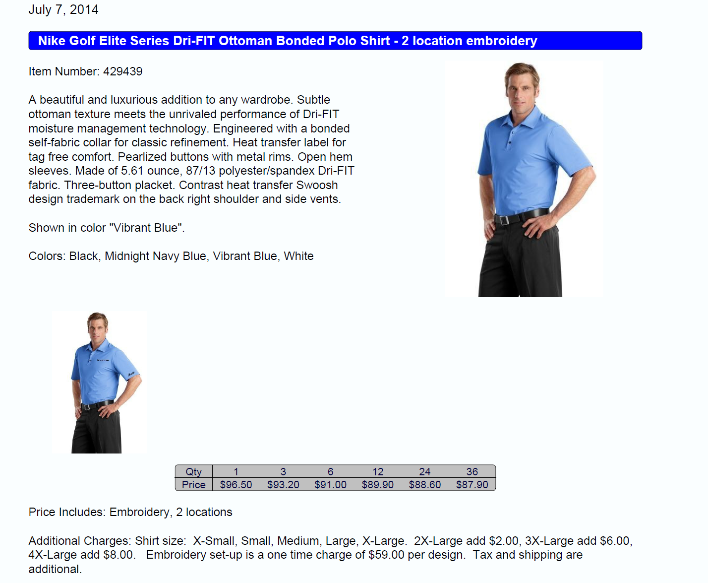
Logod Gear Proposal – Part 1

Slide 12
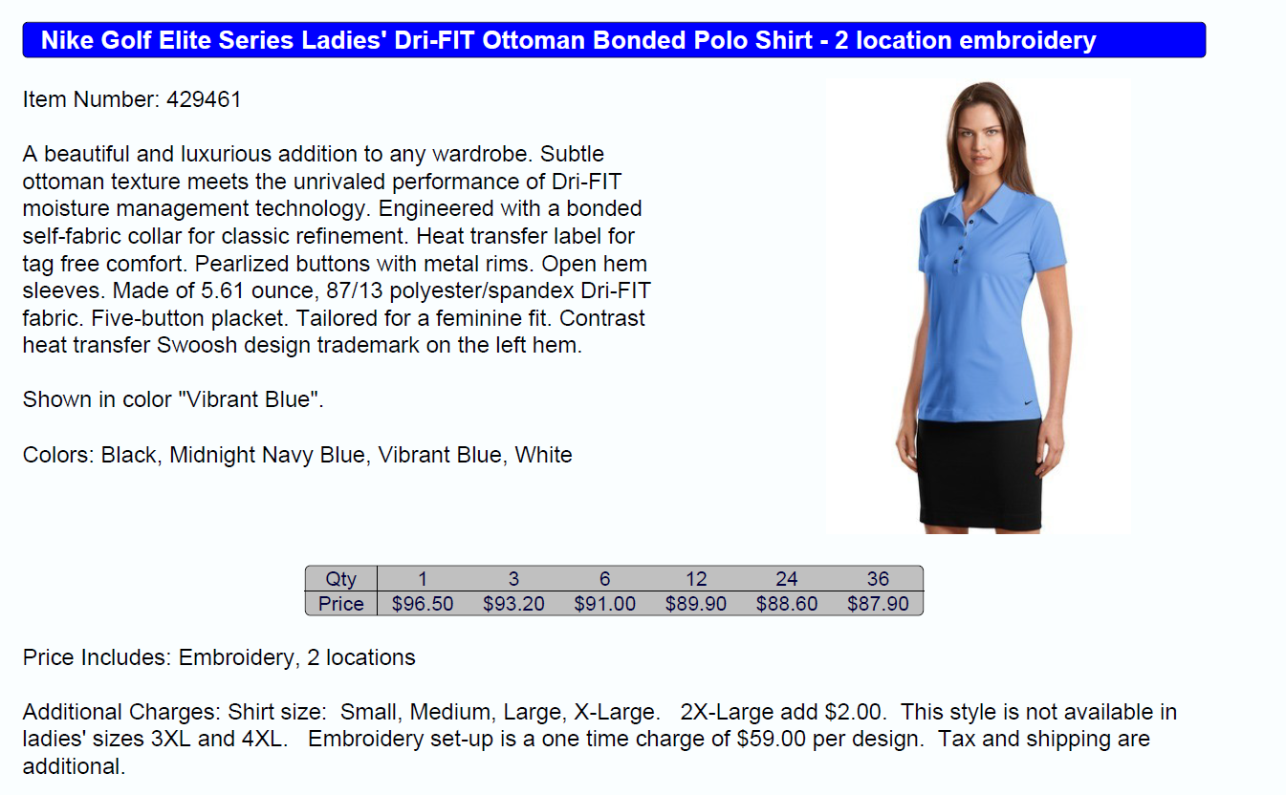
Logod Gear Proposal – Part 2

Slide 13
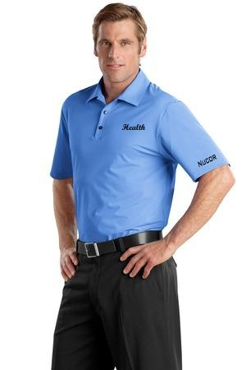
Logod Gear Proposal
Example with 2 Location Embroidery
Return

Slide 14
Hoover’s Proposal
ROI CHALLENGES AND OPPORTUNITIES - TIME IS MONEY
You would spend much more of the already limited resources now just by the man hours spent looking for the right data
Where would your valuable time be best spent?
Most importantly, Hoovers Online ensures that you are spending the greatest portion of the day in sponsorship and results producing activities.
RECOMMENDATION
Being a Dun and Bradstreet company, businesses are reporting their information to us in order to keep their credit file up to date as well as their Hoover's profile in the best shape possible. Last year we spent a quarter billion in research and made 115 million phone calls verifying information. D&B does business with over 98% of the Business Week Global 1000 and was ranked #1 on Fortune Magazine's Financial Information Services industry list of "America's Most Admired Companies" three years in a row. These achievements reflect our ongoing commitment to delivering quality commercial insight to our customers.
BENEFIT TO YOU AUTOMATICALLY INCLUDED IN HOOVERS: -
Easy to setup and user friendly online interface with unlimited research capabilities
Generate lists of businesses by geography, size, industry, job titles, and more
Download up to 100,000 unique company DUNS numbered records into any CRM
Unlimited view of contact names, titles, profiles, mailing addresses, and primary phone number
Customer support and customized training included
      Standard Corp Rate - $6,000 per year
      Nonprofit Rate - $4,800 per year
      PAYMENT AND DISCOUNT OPTIONS
      Pay in full, get a 5% discount
      4 Quarterly Installments
      Monthly with 2/12 Down payment
      24 month license – additional 5% discount
      36 month license – additional 10% discount
Return

